Slide 1

Follow-up After Applying for a Job

Slide 2
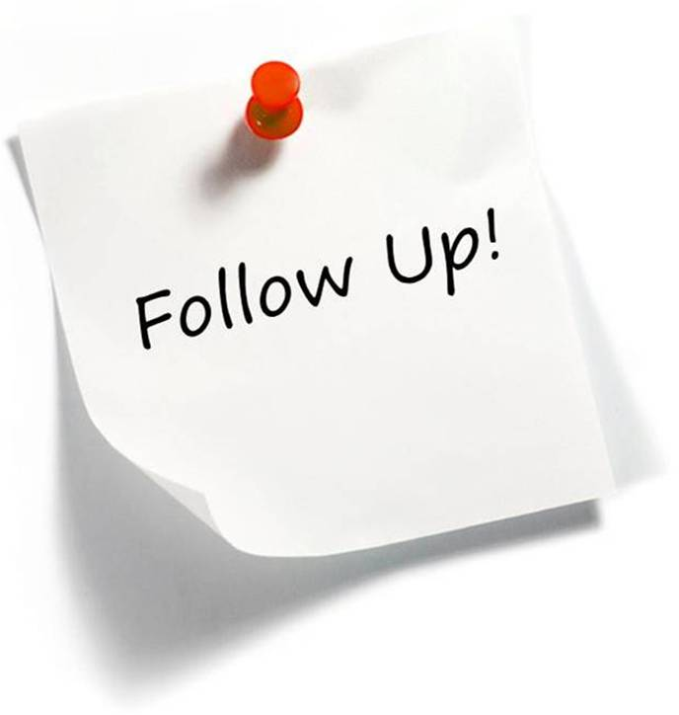
Why should you follow-up on job applications?
Confirms submission
Shows interest
More likely to get an interview

Slide 3

How to Follow-Up after Submitting Your Resume?
Call the person who is identified in the job posting
Call the company and ask for the hiring manager
Make your phone call from a place free of distractions
Be prepared for a short screening interview; they may do it right then
Keep the job description and your resume nearby, you may need to refer to it
Thank the person for his/her time and ask or confirm about the hiring timetable/next steps.

Slide 4
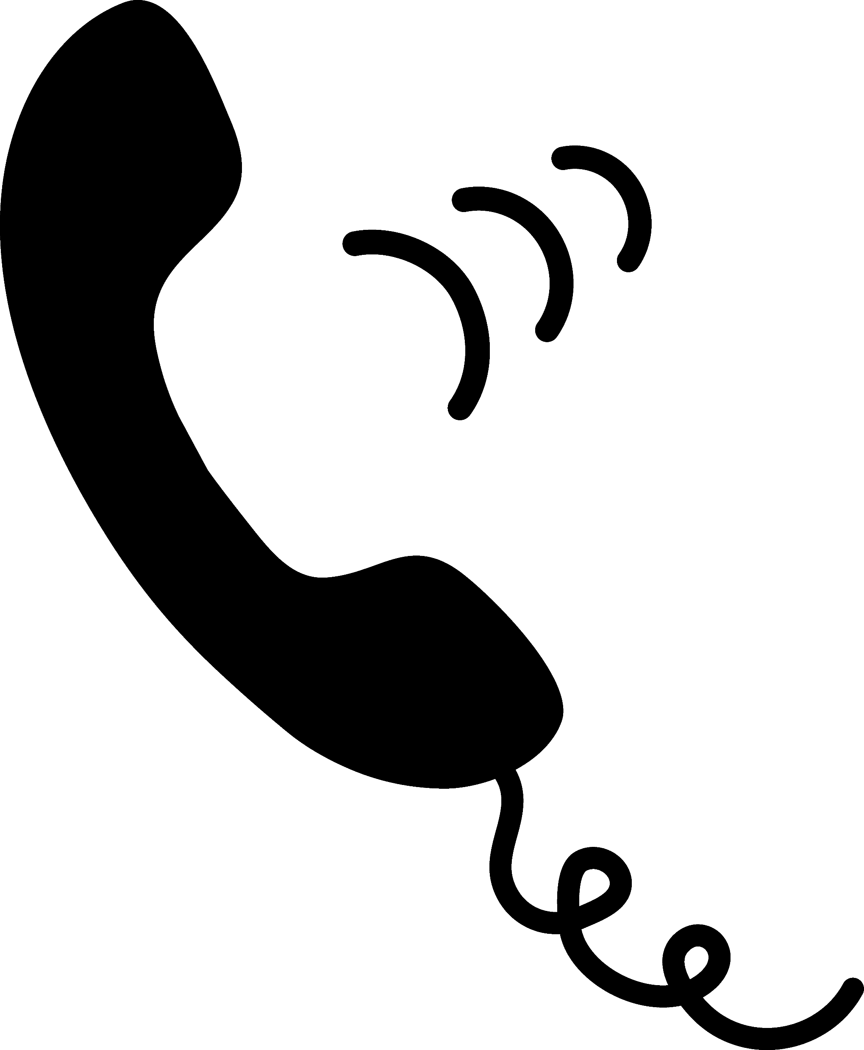
What should I say?
Hi, this is ______
I am following up on my application for the _______ position. I just wanted to make sure you received it and to let you know I’m very interested in this position. I would like discuss my qualifications and how they can benefit your company. (Mention one of your USPs customizing it based on job description) I’m available for an interview at your convenience.
When leaving a phone message remember to give your name & phone number - slowly, clearly, loudly.

Slide 5

Follow-Up by Email
Keep your email short and to the point. Simply again state your interest in the job and your key qualifications for the position and your USP
Be sure to spell-check and proofread your e-mail before sending it (I strongly recommend using Grammarly.com)
Check your email inbox & Spam folder regularly, so you can respond quickly

Slide 6
When to Follow-Up & What to Say
After Submitting Resume to Staffing Company
Call
When: Same day/Next day
I am following up on my application for the _______ position. If you have any further questions about my qualifications, please let me know. I look forward to hearing about the next steps in the process.
After Recruiter/HR Screening
Call/email
When: Date given / 1 week
Hi, this is ______. My phone number is 641-472-7000.
I talked with you last week about the ______ position. Can you please tell me what the next step in the process is? Again, that’s 641-472-7000. Thank you for your time.
After Hiring Manager Interview
Call/email
When: Date given / 1 week
Hi, this is _____.
I greatly enjoyed my interview with you and I am still interested in the ______ position. Can you please tell me if I am still a candidate? My phone number is…….
I look forward to hearing from you.

Slide 7
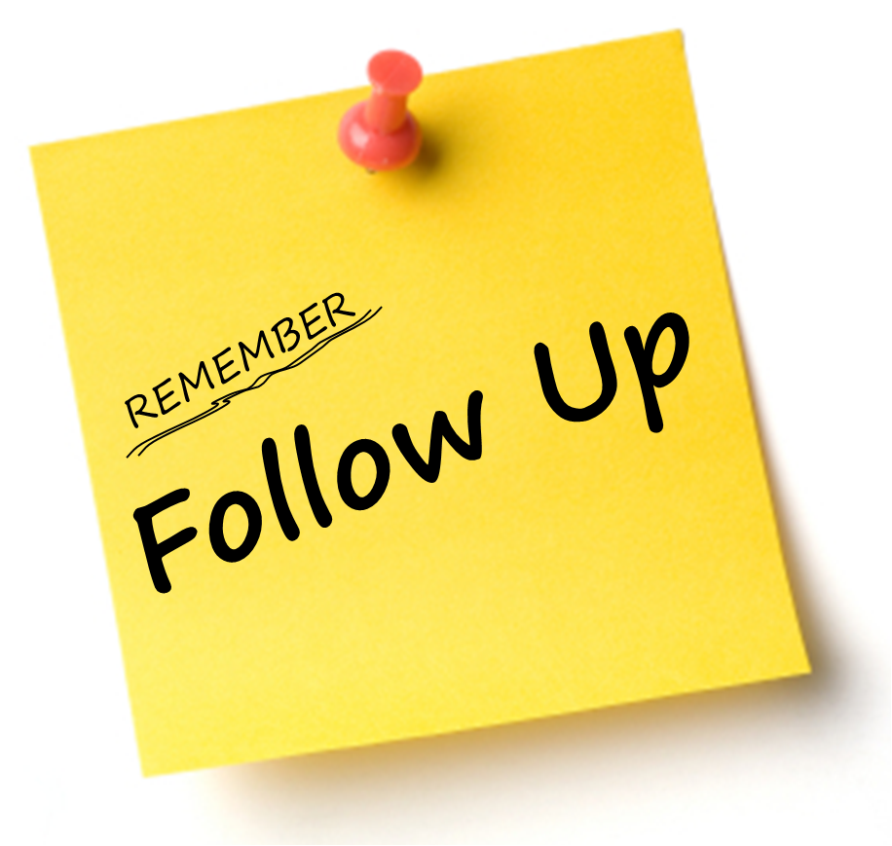
Tips for Following-up
Keep your follow-up brief, to the point, and professional.
When sending an email, use a clear subject line: Job Title – Your Name
Ask the employer where they are with the hiring process. When do they plan to make a decision?
Offer more detailed information about your skills and background mention your USP (customized to the job description)
Ask the hiring manager if he/she needs any further information.

